Slide 1

About | Demo | Results | Policy
How filters censor the internet
Richard King
richard@openrightsgroup.org
@graphiclunarkid
Ruth Coustick-Deal
ruth@openrightsgroup.org
@nesient
www.blocked.org.uk
Notes:
Today we're going to tell you about an ORG campaign to raise awareness of the problems caused by web censorship in the UK.
We're going to fill you in on the background and reasons for the campaign.
We're then going to demonstrate a tool we built that lets you check whether a site is being blocked.
Then we're going to finish up with a discussion of what the tool has found so far and the policy changes for which we're pushing.

Slide 2

Defensibility (shades of grey)
What is censored
and why?
The motte and bailey of Clough Castle
© Eric Jones (License: CC-BY-SA)
Notes:
These are the ruins of a motte and bailey castle at Clough in the North East of England.
It has a strong and easily defended Keep on top of this motte.
It has a raised Bailey area with more desirable land, but not so easily defended
And it has green fields beyond, rich and fertile, but very difficult to defend.
These ruins are going to help me illustrate how content filtering in the UK varies from the defensible through the inconvenient to the downright risky.
The UK censors three types of content.

Slide 3
Defensibility (shades of grey)
Criminal
content
Notes:
Child abuse is abhorrent. Therefore arguments in favour of censoring images of this abuse are the most easily defended.
Yesterday Downing Street announced that materiel contravening any of the various terrorism acts will be blocked similarly to child abuse images.
We think there needs to be transparency whenever censorship occurs for political reasons, and there's also doubt over the effectiveness of blocking as a tactic against this sort of content, as opposed to having it removed at source (for example).
However our campaign doesn't engage with this category of censorship directly. This content is at the top of the slippery slope. Its shade of grey is closer to black.

Slide 4
Defensibility (shades of grey)
Criminal
content
Infringing content
(e.g. © or ™)
Notes:
The blocking of websites that facilitate copyright, trademark, or other forms of civil infringement is controversial. Further down the slippery slope and less black-and-white than blocking child abuse images.
At least where these blocks exist in the UK they have been imposed by a court after due process.
However we think there could be better safeguards for consumers, such as time limits, minimisation of collateral damage, and making what has happened visible to the people who try to access these sites.

Slide 5
Defensibility (shades of grey)
Criminal
content
Infringing content
(e.g. © or ™)
Legal content
Notes:
Legal-content filters are the least defensible form of censorship in the UK. At best they are chosen actively by an individual and affect only that person. At worst they could be used by malicious actors to enforce their world views on others and deny people access to information.
Legal-content filters extend from censoring the extreme to the esoteric. And that's assuming they work as advertised. But they don't. All sorts of legitimate websites get blocked in error while many sites of the type casual users might expect to be blocked are let through.
That's why legal-content filters are the focus of our campaign.
Put your hands up if you have a mobile phone that can access the internet.
Keep them up if you've ever run into a page you couldn't access on it because of some kind of filter.
Now only keep them up if you've had your mobile provider remove that filter so you can access the web unhindered.
OK, I'm going to show you a video now. You people with your hands still up – see if you can relate.

Slide 7
How web-filters work politically
Good websites
Bad websites
Notes:
This is how the Government wants you to think web filters work.
Their legal-content censorship policy only make sense if it's possible to divide up the web into good websites and bad (but still legal) ones, and then block only the bad sites.
“One click to protect your whole home and to keep your children safe.”
This is what David Cameron announced and it's what parents are being sold by the ISPs that are nodding along with him.
Does this ring true for you? Or is the experience of our long-suffering cook closer to yours?

Slide 8
How web-filters really work
Good websites
Bad websites
Notes:
This is closer to how web filters really work.
Many bad (but legal) websites are blocked – but some get through. We call this underblocking.
Similarly overblocking is where good websites are blocked in error.
Filters cost ISPs money and they have little incentive to strive for excellence. They all outsource the job to companies abroad so can blame someone else for failures.
So what other problems are there with web filters?

Slide 9
Problems with web-filters
Overblocking (and underblocking)
False sense of security
Categories that are unnecessary or too broad
Wrong people get filtering
Notes:
We know they don't work as well as industry and the Government claim. They just block a bunch of sites, some of which are good, some of which are bad, and all of which are legal.
But the promise of “one click to safeguard your family” can lead care-givers into complacency. We've flicked the magic safety switch! All is well! No more parenting needed!
“Added value” optional categories are offered by ISPs – these can be very broad and problematic.
Whole household products are indiscriminate – individuals should have a choice.
People tend to accept defaults. The 'nudge theory' that the Government uses to try to influence our decisions and behaviour takes that as a given.
Encouraging everyone to accept adult Internet filters means millions of adults will lose access to all sorts of material rightly or wrongly categorised inappropriate for under-18s.
Mobile companies just assume you're a child.

Slide 10
Problems with web-filters
No effective oversight of blocking
Complaints are dealt with badly
Monitoring censorship is hard
No way for website owners to check who is blocking them
Notes:
Although Ofcom and the British Board of Film Classification are both now involved, there is little meaningful oversight of website classification. It's just left to the judgement of the largely foreign companies to whom filtering is outsourced.
Difficult to get sites unblocked. Complain to your ISP and the typical response is “would you like us to switch filtering off”? This solves the problem of misclassification for neither the customer the nor site owner.
Each network's filters work differently so independent monitoring is hard.
If you own a website, how do you find out if it's being blocked? ISPs won't tell you!

Slide 11
www.blocked.org.uk
Free software - github.com/openrightsgroup
Built by ORG's technical volunteers
Sponsored by Bytemark, Andrews & Arnold
Checks whether your site is blocked on
  All UK mobile networks
  Most UK home broadband networks
Collects reports of filtering failures
Advises on correcting inappropriate blocks
Notes:
That's why we built blocked.org.uk
You can visit this site and type in the URL of another site or page.
The tool will then check whether that page is blocked.
Our kind sponsors provided not only hosting space for the site but also subscriptions to all the main UK ISPs so that we could do this checking.
The entire thing is Free software and it was built by an awesome team of volunteers – some of whom might be here today.
The site also collects reports of filtering failures and later Ruth is going to talk about the results we've found so far.

Slide 12
Demo time!
Notes:
But right now we thought we'd show you the site in action – assuming it's still working that is!
<load page in browser>
Does anyone want to suggest a website for me to check for filtering?
At the start a few of you said you had mobile phones with internet access. Would those people please head over to blocked.org.uk now and start bashing in the sites you own, or the ones you visit often, and see what results you get?
Check 3 x websites
Ask if anyone has found any interesting results

Slide 13
Our Findings
Or what we learnt from blocked.org.uk that we didn’t know before
Presented through the medium of Powerpoint

Slide 14
Our Findings

Slide 15
Our Findings

Slide 16
Our Findings

Slide 17
Our Findings

Slide 18
Top UK ISPs

Slide 19
Our Findings

Slide 20
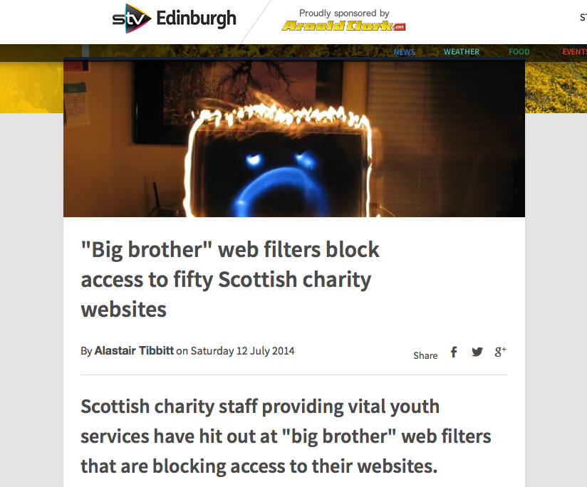
Our Findings

Slide 21
Our Findings
"I can't see how blocking our website is making anything any safer. It's making it less safe because people can't access the required help”
Brian Cowie
Manager and Senior Recovery Support Practitioner at Aberdeen based charity, Alchohol Support

Slide 22
Our Findings

Slide 23
UN Special Rapporteur's report on children's rights and freedom of expression
“The result of vague and broad definitions of harmful information, for example in determining how to set Internet filters, can prevent children from gaining access to information that can support them to make informed choices, including honest, objective and age-appropriate information about issues such as sex education and drug use.”

Slide 24
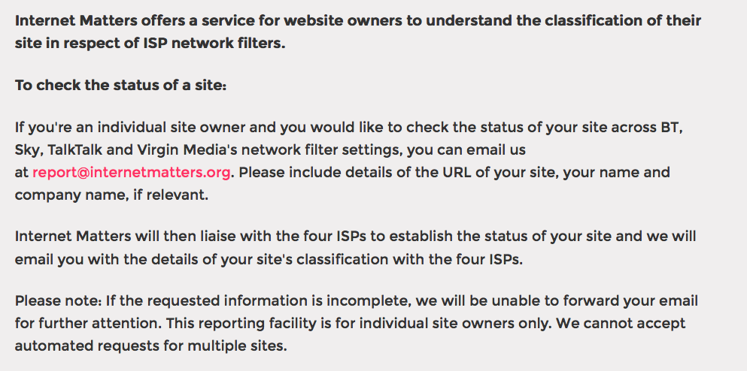
Official site-unblocking method

Slide 25
Reporting overblocking
"BT is committed to working with all stakeholders to minimise instances of over-blocking. All our categorisation is done by our third party specialist supplier. Sites that are believed to be incorrectly blocked by BT Parental Controls can be reported by e-mail to categorisation@bt.com. We will then investigate them with our supplier.”

Slide 26
About | Demo | Results | Policy
Thank you! Any questions?
Richard King
richard@openrightsgroup.org
@graphiclunarkid
Ruth Coustick-Deal
ruth@openrightsgroup.org
@nesient
www.blocked.org.uk
Notes:
This project is far from complete and there are loads of exciting directions in which we could take it next.
But to do that we need your help.
If you are a coder, documenter, website owner, educator, graphic artist, videographer, speak more than one language or simply have a great idea for this project, please take a card as you leave – they're different to the ones we were handing out on the way in – and check out the URL that tells you how to get involved.
Don't forget to hand out Inventory Item cards as people leave!

Slide 27
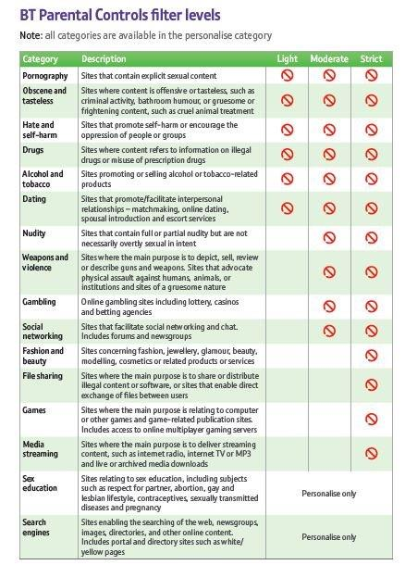
BT parental controls – filter levels
Pornography
Obscene & tasteless
Hate & self-harm
Drugs
Alcohol & tobacco
Dating
Nudity
Weapons & violence
Gambling
Social networking
Fashion & beauty
File-sharing
Games
Media streaming
Sex education
Search engines
Notes:
This is the actual size of the JPEG BT gave us to help understand their filters – we've tried to make it a bit clearer here on the left.
Obscene and tasteless category includes “toilet humor” on a par with “criminal activity” and is blocked by default
Drugs category includes “information on illegal drugs” and is blocked by default
Sites selling alcohol & tobacco are blocked by default – because we have a big problem with kids downloading booze and getting drunk on the web.
You can block non-sexual nudity – but kids can look at their own bodies in real life
The social networking, file-sharing, media streaming and search engine categories are censorship by form not by content.
Sex education category includes “respect for family” which I understand is a euphemism for domestic violence.
We think there is some danger in these categories being available for people to apply: they are too broad for most young users.
https://wiki.openrightsgroup.org/wiki/BT_Parental_Controls

